Slide 1
Temporal Tables SQL Server’s Built-In Wayback Machine
DevSpace Conference
12 October 2019
Allison Benneth
@sqltran www.sqltran.org

Slide 2
DevSpace would like to thank our sponsors

Slide 3
Welcome to DevSpace
Enjoy these two days of learning
Be sure to visit and thank the sponsors
Be sure to thank the organizer and volunteers
Take time to NETWORK with others. That’s what this is really all about!
Act professionally and treat others with respect (like this was a work environment)

Slide 4
What we’ll cover
How temporal tables can be used
Behind the scenes: how they work
Creating a temporal table
Querying temporal tables
Miscellaneous topics

Slide 5
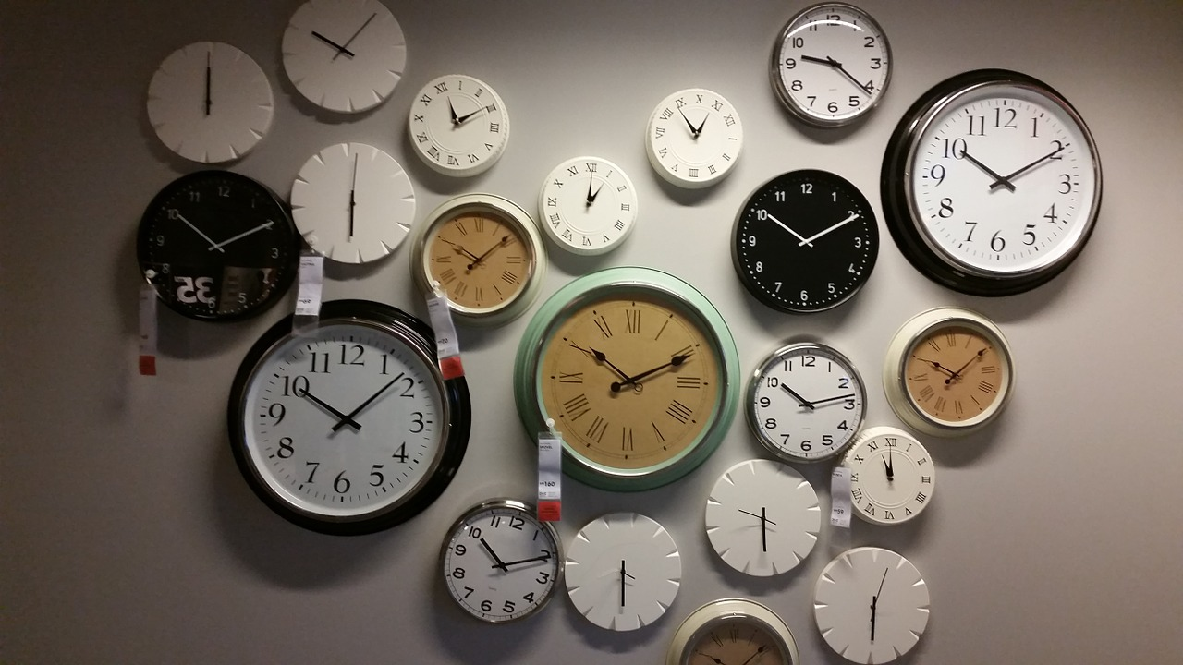
Temporal tables
Temporal = time-based = system versioned
Introduced in SQL Server 2016
https://pixabay.com/photos/wall-clocks-time-clock-timing-534267
Notes:
Most real-world databases have long have temporal components:
We keep track of when a row was inserted or updated
We want to know what changed – when, what, who?
Traditionally accomplished with triggers, CDC/CT or other methods (in the app, for instance)
These methods usually require some form of coding

Slide 6
Temporal tables
Main purposes
Logging
Reversal of changes
Anomaly detection
Point-in-time business analytics
Trends
https://pixabay.com/illustrations/black-hole-galaxy-science-space-4092609
Notes:
Most real-world databases have long have temporal components:
We keep track of when a row was inserted or updated
We want to know what changed – when, what, who?
Traditionally accomplished with triggers, CDC/CT or other methods (in the app, for instance)
These methods usually require some form of coding

Slide 7
Temporal tables
Other purposes – but with complexity / caveats
Auditing
Change detection
Temporal data capture
Slowly-changing dimensions
https://pixabay.com/illustrations/audit-tax-inspection-auditor-3929140
Notes:
Most real-world databases have long have temporal components:
We keep track of when a row was inserted or updated
We want to know what changed – when, what, who?
Traditionally accomplished with triggers, CDC/CT or other methods (in the app, for instance)
These methods usually require some form of coding

Slide 8
How Temporal Tables Work

Slide 9
How it works
ID | Address | City | State | Start | End
51905 | 13777 NE Grandys St | Omaha | NE | 1/1/19 | 12/31/99
57400 | 922 NE Ribstone Ln | Garden Grove | CA | 2/15/19 | 12/31/99
24009 | 4068 N Tillingbourne St | Miami Gardens | FL | 3/31/19 | 12/31/99
46627 | 548 S Castlehaven Ln | Shreveport | LA | 9/4/19 | 12/31/99
20052 | 806 E Aste St | Greenville | NC | 10/10/19 | 12/31/99

Slide 10
How it works
ID | Address | City | State | Start | End
ID | Address | City | State | Start | End
51905 | 13777 NE Grandys St | Omaha | NE | 1/1/19 | 12/31/99
57400 | 922 NE Ribstone Ln | Garden Grove | CA | 2/15/19 | 12/31/99
24009 | 4068 N Tillingbourne St | Miami Gardens | FL | 3/31/19 | 12/31/99
46627 | 548 S Castlehaven Ln | Shreveport | LA | 9/4/19 | 12/31/99
20052 | 806 E Aste St | Greenville | NC | 10/10/19 | 12/31/99

Slide 11
How it works
ID | Address | City | State | Start | End
51905 | 13777 NE Grandys St | Omaha | NE | 1/1/19 | 10/12/19
ID | Address | City | State | Start | End
51905 | 13777 NE Grandys St | Omaha | NE | 1/1/19 | 12/31/99
57400 | 922 NE Ribstone Ln | Garden Grove | CA | 2/15/19 | 12/31/99
24009 | 4068 N Tillingbourne St | Miami Gardens | FL | 3/31/19 | 12/31/99
46627 | 548 S Castlehaven Ln | Shreveport | LA | 9/4/19 | 12/31/99
20052 | 806 E Aste St | Greenville | NC | 10/10/19 | 12/31/99

Slide 12
How it works
ID | Address | City | State | Start | End
51905 | 13777 NE Grandys St | Omaha | NE | 1/1/19 | 10/12/19
ID | Address | City | State | Start | End
51905 | 2153 N Marazzani Ln | Crown Point | IN | 10/12/19 | 12/31/99
57400 | 922 NE Ribstone Ln | Garden Grove | CA | 2/15/19 | 12/31/99
24009 | 4068 N Tillingbourne St | Miami Gardens | FL | 3/31/19 | 12/31/99
46627 | 548 S Castlehaven Ln | Shreveport | LA | 9/4/19 | 12/31/99
20052 | 806 E Aste St | Greenville | NC | 10/10/19 | 12/31/99

Slide 13
How it works
ID | Address | City | State | Start | End
51905 | 13777 NE Grandys St | Omaha | NE | 1/1/19 | 10/12/19
24009 | 4068 N Tillingbourne St | Miami Gardens | FL | 3/31/19 | 10/12/19
ID | Address | City | State | Start | End
51905 | 2153 N Marazzani Ln | Crown Point | IN | 10/12/19 | 12/31/99
57400 | 922 NE Ribstone Ln | Garden Grove | CA | 2/15/19 | 12/31/99
24009 | 4068 N Tillingbourne St | Miami Gardens | FL | 3/31/19 | 12/31/99
46627 | 548 S Castlehaven Ln | Shreveport | LA | 9/4/19 | 12/31/99
20052 | 806 E Aste St | Greenville | NC | 10/10/19 | 12/31/99

Slide 14
How it works
ID | Address | City | State | Start | End
51905 | 13777 NE Grandys St | Omaha | NE | 1/1/19 | 10/12/19
24009 | 4068 N Tillingbourne St | Miami Gardens | FL | 3/31/19 | 10/12/19
ID | Address | City | State | Start | End
51905 | 2153 N Marazzani Ln | Crown Point | IN | 10/12/19 | 12/31/99
57400 | 922 NE Ribstone Ln | Garden Grove | CA | 2/15/19 | 12/31/99
46627 | 548 S Castlehaven Ln | Shreveport | LA | 9/4/19 | 12/31/99
20052 | 806 E Aste St | Greenville | NC | 10/10/19 | 12/31/99

Slide 15
Instance and database configuration
Instance-level configuration required for temporal tables
Database-level configuration required for temporal tables

Slide 16
Creating Temporal Tables

Slide 17
Create temporal table
create table dbo.Manufacturer
(
ManufacturerId int not null identity(1,1),
ManufacturerName nvarchar(50) not null,
ValidFrom datetime2 generated always as row start not null,
ValidTo datetime2 generated always as row end not null,
period for system_time (ValidFrom, ValidTo),
constraint pk_Manufacturer primary key clustered (ManufacturerId)
);

Slide 18
Create temporal table
create table dbo.Manufacturer
(
ManufacturerId int not null identity(1,1),
ManufacturerName nvarchar(50) not null,
ValidFrom datetime2 generated always as row start not null,
ValidTo datetime2 generated always as row end not null,
period for system_time (ValidFrom, ValidTo),
constraint pk_Manufacturer primary key clustered (ManufacturerId)
);

Slide 19
Create temporal table
create table dbo.Manufacturer
(
ManufacturerId int not null identity(1,1),
ManufacturerName nvarchar(50) not null,
ValidFrom datetime2 generated always as row start not null,
ValidTo datetime2 generated always as row end not null,
period for system_time (ValidFrom, ValidTo),
constraint pk_Manufacturer primary key clustered (ManufacturerId)
);

Slide 20
Create temporal table
create table dbo.Manufacturer
(
ManufacturerId int not null identity(1,1),
ManufacturerName nvarchar(50) not null,
ValidFrom datetime2 generated always as row start not null,
ValidTo datetime2 generated always as row end not null,
period for system_time (ValidFrom, ValidTo),
constraint pk_Manufacturer primary key clustered (ManufacturerId)
)
with (system_versioning = on);

Slide 21
Three ways to create history table
Let SQL Server create and name it
Let SQL Server create it with a name of your choosing
Create and name it yourself

Slide 22
History table (let SQL Server name it)
create table dbo.Manufacturer (...)
with (system_versioning = on);
SQL Server creates a table with a name like:
dbo.MSSQL_TemporalHistoryFor_565577053

Slide 23
History table (let SQL Server create it)
create table dbo.Manufacturer (...)
with (system_versioning = on
(history_table = history.ManufacturerHistory));

Slide 24
History table (DIY)
create table history.ManufacturerHistory
(
ManufacturerId int not null,
ManufacturerName nvarchar(50) not null,
ValidFrom datetime2 not null,
ValidTo datetime2 not null
);
create table dbo.Manufacturer(...)
with (system_versioning = on
(history_table = history.ManufacturerHistory));

Slide 25
History table (DIY)
When creating your own history table
Must have same structure, data types, nullability
Cannot have constraints (primary key, foreign keys, etc.)
None of these:
generated always as row start / end
period for system_time
identity
So why DIY?

Slide 26
History table defaults
History tables created by SQL Server are page compressed
Consider page compressing DIY history tables as well
create table history.CustomerHistory
(...) with (data_compression = page);
Clustered index on history table created by SQL is on (ValidTo, ValidFrom)
Consider appropriate clustered index for all history tables, whether SQL-created or DIY

Slide 27
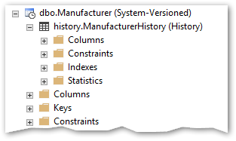
SSMS and temporal tables

Slide 28
datetime2(n)
Introduced in SQL Server 2008
Has a date range from 0001-Jan-01 to 9999-Dec-31
When declaring, give an optional precision from 0 to 7
Default is 7
Represents number of digits in fractional part of a second
Maximum/default precision is thus 100 ns (0.0000001 s)
All system-generated times in temporal tables are UTC
9999-12-31 23:59:59.9999999
Heat death of the universe

Slide 29
Writing to temporal tables
insert dbo.Manufacturer (ManufacturerName)
values ('Acme, Inc.');
select * from dbo.Manufacturer;
select * from history.ManufacturerHistory;

Slide 30
Writing to temporal tables
update dbo.Manufacturer
set ManufacturerName = 'XYZ Corp.'
where ManufacturerId = 1;
select * from dbo.Manufacturer;
select * from history.ManufacturerHistory;

Slide 31
Writing to temporal tables
delete from dbo.Manufacturer
where ManufacturerId = 1;
select * from dbo.Manufacturer;
select * from history.ManufacturerHistory;

Slide 32
Hidden columns
create table dbo.Manufacturer
(
ManufacturerId int not null identity(1,1),
ManufacturerName nvarchar(50) not null,
ValidFrom datetime2 generated always as row start hidden not null,
ValidTo datetime2 generated always as row end hidden not null,
period for system_time (ValidFrom, ValidTo),
constraint pk_Manufacturer primary key clustered (ManufacturerId)
)
with (system_versioning = on);

Slide 33
Hidden columns
insert dbo.Manufacturer (ManufacturerName)
values ('Acme, Inc.');
select * from dbo.Manufacturer;
select ManufacturerId, ManufacturerName, ValidFrom, ValidTo from dbo.Manufacturer;

Slide 34
Hidden columns
insert dbo.Manufacturer
values ('XYZ Corp.');
This works OK with “hidden” attribute
If “hidden” attribute was missing:
Msg 213, Level 16, State 1, Line 35
Column name or number of supplied values does not match table definition.

Slide 35
Summary of creating temporal tables

Slide 36
Querying Temporal Tables

Slide 37
Querying temporal tables
Temporal table can be queried just like any other table
History table can be queried just like any other table
SQL now provides a new clause (used with temporal table)
for system_time
Is followed by one of five time period definitions
select …
from dbo.Manufacturer
for system_time as of '2019-10-12 16:00';

Slide 38
Querying temporal tables
for system_time performs a “logical” concatenation (UNION ALL) on the temporal table plus the history table.
ID | Address | City | State | Start | End
51905 | 2153 N Marazzani Ln | Crown Point | IN | 10/12/19 | 12/31/99
57400 | 922 NE Ribstone Ln | Garden Grove | CA | 2/15/19 | 12/31/99
46627 | 548 S Castlehaven Ln | Shreveport | LA | 9/4/19 | 12/31/99
20052 | 806 E Aste St | Greenville | NC | 10/10/19 | 12/31/99
ID | Address | City | State | Start | End
51905 | 13777 NE Grandys St | Omaha | NE | 1/1/19 | 10/12/19
24009 | 4068 N Tillingbourne St | Miami Gardens | FL | 3/31/19 | 10/12/19

Slide 39
Querying temporal tables
Temporal querying: FROM TableName FOR SYSTEM_TIME _____
Point in time | AS OF '2019-10-11 08:00:00'
Full history | ALL
Between (ValidFrom <= EndTime AND ValidTo > StartTime) | BETWEEN '2019-10-11 08:00:00' AND '2019-10-12 17:00:00'
From (ValidFrom< EndTime AND ValidTo > StartTime) | FROM '2019-10-11 08:00:00' TO '2019-10-12 17:00:00'
Contained in (ValidFrom >= StartTime AND ValidTo <= EndTime) | CONTAINED IN ('2019-10-11 08:00:00', '2019-10-12 17:00:00')

Slide 40
Querying temporal tables
Time(s) in for system_time clause can be constants or variables:
declare @asOfTime datetime2 =
'2019-10-12 16:00:00';
select …
from dbo.Manufacturer
for system_time as of @asOfTime;

Slide 41
Querying multiple temporal tables
Query against 3 temporal tables:
select …
from dbo.Manufacturer
for system_time as of '2019-10-12 16:00' mfg
join dbo.Product
for system_time as of '2019-10-12 16:00' prd
on prd.ManufacturerId = mfg.ManufacturerId
join dbo.OrderDetail
for system_time as of '2019-10-12 16:00' od
on od.ProductId = prd.ProductId
where prd.Name = 'Widget';
Can be clunky and error prone

Slide 42
Querying multiple temporal tables
Solution: Create a view
create view vwProductOrder as
select …
from dbo.Manufacturer mfg
join dbo.Product prd
on prd.ManufacturerId = mfg.ManufacturerId
join dbo.OrderDetail od
on od.ProductId = prd.ProductId

Slide 43
Querying multiple temporal tables
Then query the view
select …
from vwProductOrder
for system_time
as of '2019-10-12 16:00' po
where po.Name = 'Widget';

Slide 44
Miscellaneous Topics

Slide 45
Miscellaneous topics
Effect of transactions on insert/update/delete operations
Propagation of schema changes
AT TIME ZONE function
select sysdatetime() at time zone 'Central Standard Time’ at time zone 'UTC';
select sysdatetimeoffset() at time zone 'UTC’;
Performance considerations
Indexing the history table

Slide 46
Retention and archiving
Built-in method in SQL 2017+ only
Retention only, no archiving
create table dbo.Customer
(
…
)
with (system_versioning = on
(history_table = history.CustomerHistory,
history_retention_period = 3 months));

Slide 47
Retention and archiving (SQL 2016+)
Stretch database (move data to table in Azure, becomes extension of history table)
Custom scripts
Partitioning on history table (and optional archive table)
Trickle copy and/or delete

Slide 48
Miscellaneous topics
New catalog objects
sys.periods (view)
sys.tables.temporal_type (column)
sys.tables.temporal_type_desc (column)
sys.tables.history_table_id (column)
sys.columns.generated_always_type (column)
sys.columns.generated_always_type_desc (column)

Slide 49
Thank You
This presentation and supporting materials can be found at www.sqltran.org/temporal.
Slide deck
Scripts
allison@sqltran.org • @sqltran

